Slide 1


Data Science
Final Project Presentation
Class: IBM IMVAI-1901
Team: 3
Team Members:
Diana Koh, Leong Sunyoi,
Raymond Ang, Vincent Chun

Slide 2
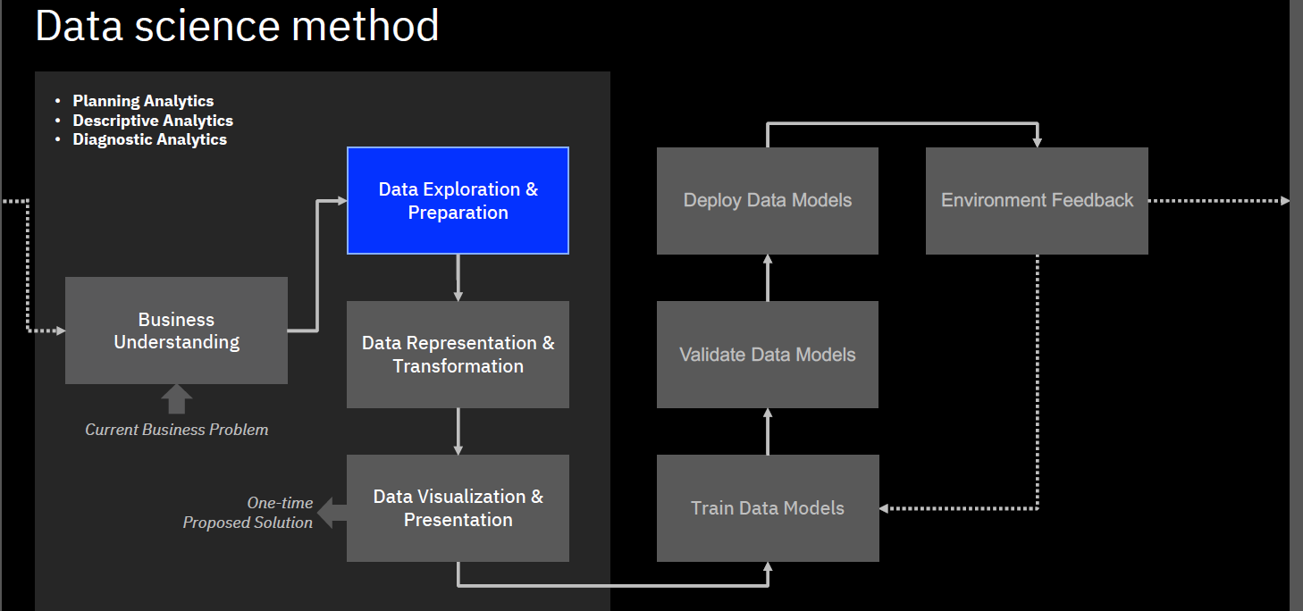
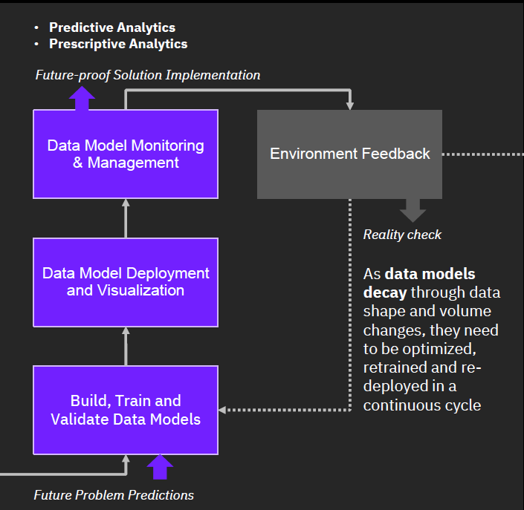
Data Science Method

Slide 3
Agenda
Diana Koh
Introduction
Planning Analytics
Leong Sunyoi
Descriptive Analytics
Diagnostic Analytics
Raymond Ang
Predictive Analytics
Vincent Chun
Prescriptive Analytics
Summary and Reflection

Slide 4
Project Topic
According to World Health Organization (WHO), stroke is the second leading cause of death and the third leading cause of disability globally.
Stroke is the sudden death of some brain cells due to lack of oxygen when the blood flow to the brain is lost by blockage or rupture of an artery to the brain, it is also a leading cause of dementia and depression.

Slide 5
Introduction
Project Objectives
Personal – medical professionals
How might we use patients' records to assist medical professionals in predicting the probability of a patient suffering a stroke for a proof of concept.
Tools
Mural – for collaboration and Enterprise Design Thinking process
IBM Watson Studio – for data analytics
Data Refinery
Data Visualization
Auto AI
Machine Learning
Cloud Object Storage
Jupyter Notebook
Python
Libraries: Pandas Seaborn Matplotlib Numpy

Slide 6
Team Roles
Team Lead: Vincent Chun
(Sr Scientist/Sr Analyst/ Chief Engineer)
Data Analyst: Diana Koh
Data Engineer: Leong Sunyoi
Data Scientist: Raymond Ang
Extract Data
Prepare Data
Build models
Train Models
Evaluate
Deploy

Slide 7
Planning Analytics

Slide 8
Business Understanding - Problem & Opportunity
A person's quality of life is of high value. Therefore, our government believes the cost of providing wellness care to its citizens is lesser than providing care to stroke patients. It can help to save SGD$5.37 billion per year and improve its citizens quality of life by 8 years.

Slide 9
Hypothesis
Monitoring vital signs like blood pressure and blood glucose can be an effective way to help prevent a stroke.
It provides patients with the assurance they need to feel confident in pursuing lifestyle changes.
Hypertension and diabetes are major risk factors for stroke.
We would delve deeper in the presentation.

Slide 10
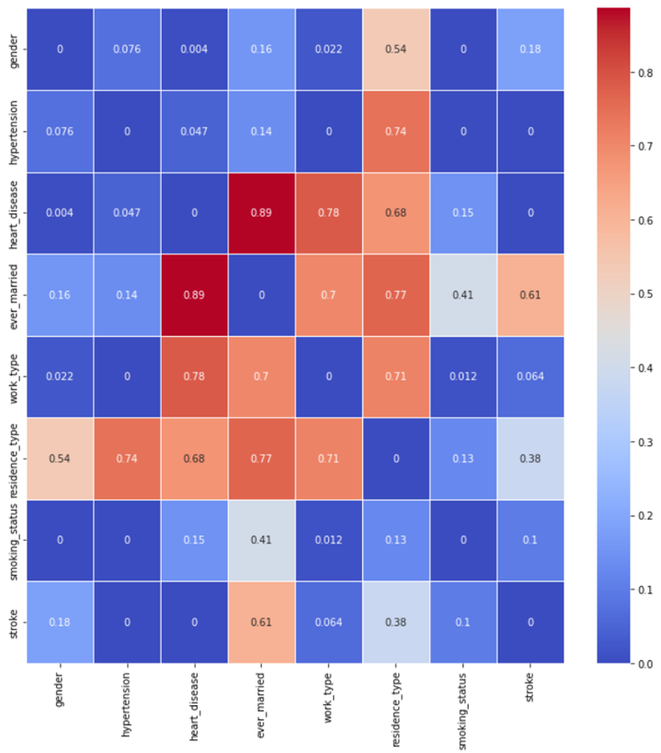
Model Hypothesis
Stroke is plot based on other categorical variables. The darker the plot, the stronger the correlation.
Therefore, the following factors are deduced from the heat map that affect stroke predictions –
Heart disease
Hypertension

Slide 11
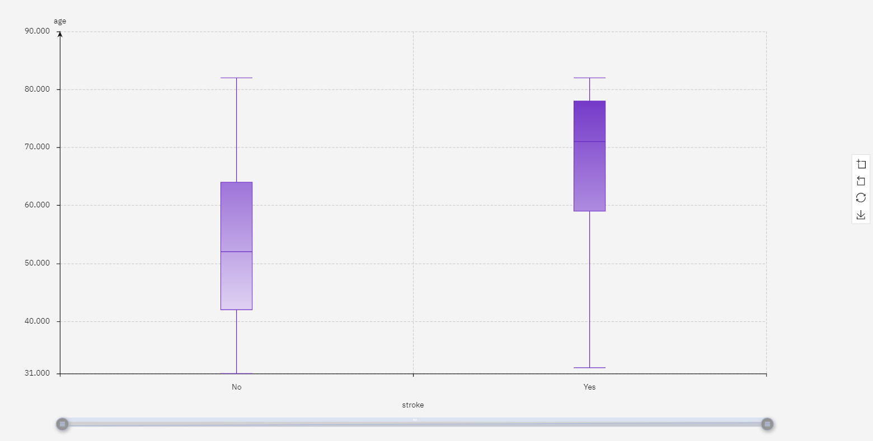
Hypothesis for our model
The risk of stroke increases with age.

Slide 12
Pain Points
Medical professional might overlook giving more attention to patients who are at higher risk of stroke.
Patient's lack of concern by their current lifestyle resulting to a lack of awareness about their probability on getting stroke based on their current habits.
Patients not supporting / believing the medical professional sufficiently in their work to minimize stroke probability.

Slide 13
HMW Statement
How might we use patients' records to assist medical professionals in predicting the probability of a patient suffering a stroke?
Our model is designed to predict the probability of a patient from age 30 onwards, having stroke based on their health indicators.
With sufficient medical care, strokes can be prevented from happening and thereby reducing healthcare costs for caring of stroke patients.

Slide 14
Descriptive Analytics

Slide 15
Data Exploration
Data source
The data comes from https://www.kaggle.com/code/rishabh057/healthcare-dataset-stroke-data/data

Slide 16
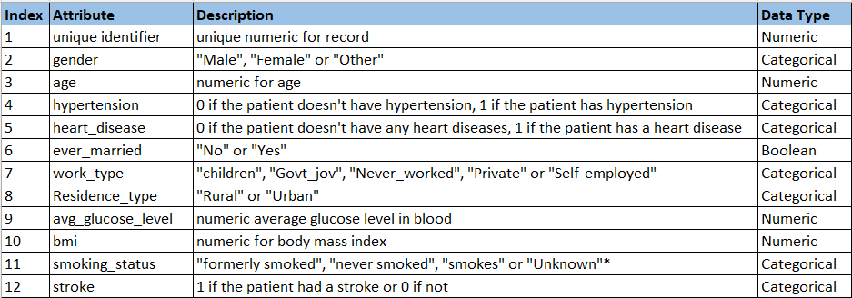
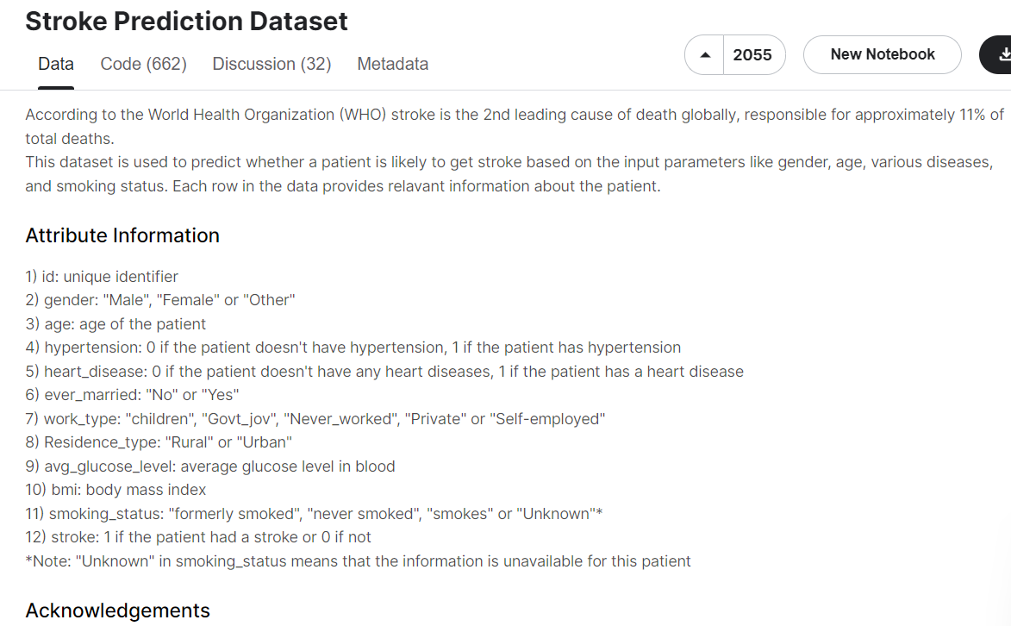
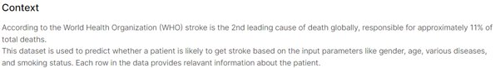
Data Dictionary
Observation
4 Numeric
7 Categorical
1 Boolean

Slide 17
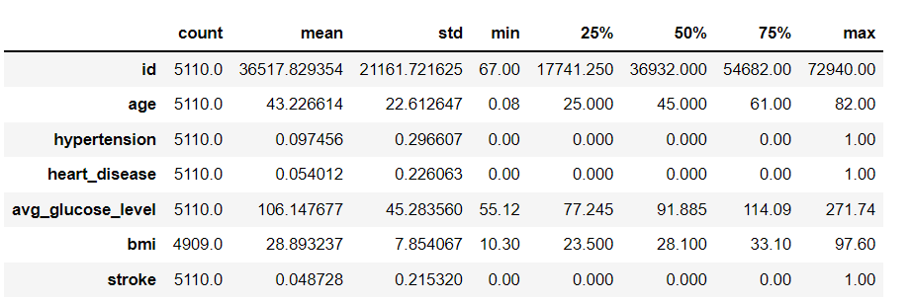
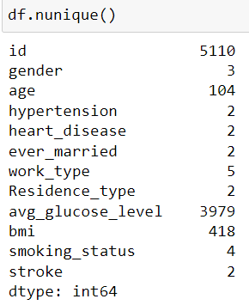
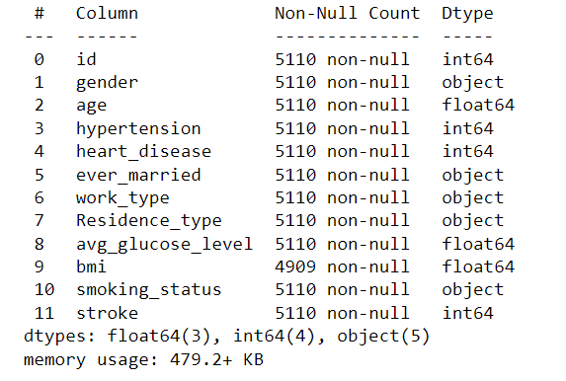
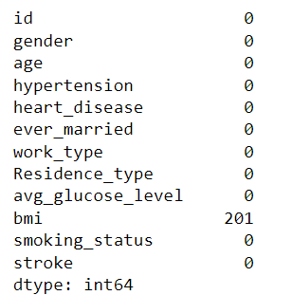
Data Exploration
Statistics of numerical features
Remove id
Hypertension, heart_disease & stroke is
numerical
value, need to convert to Boolean
Feature categories
Information of Dataset
Missing Values
Action: - to replace the missing value with Median of the BMI

Slide 18
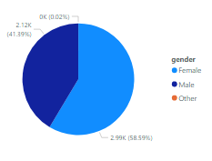
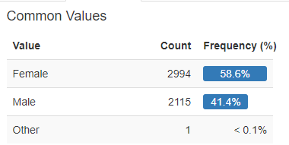
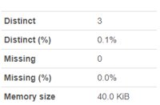
Data Exploration
gender
Observations – ​
Female is higher than male
1 count under other
To remove this 1 count
Notes:
Total 5510 rows
More females than males
Since there is no gender as ‘Other’, to remove from the dataset. Ensure only 2 distinct gender

Slide 19
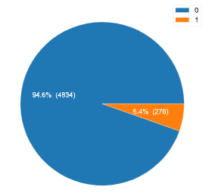
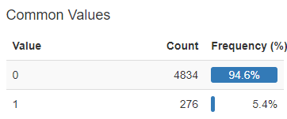
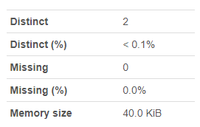
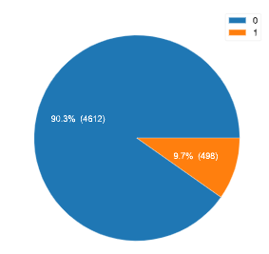
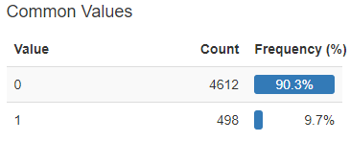
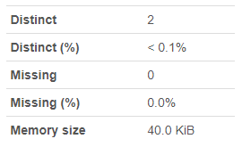
Data Exploration
heart_disease
hypertension

Slide 20
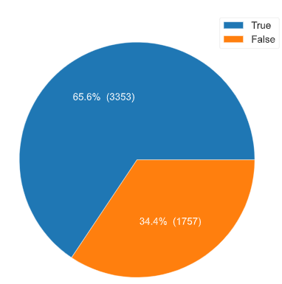
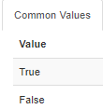
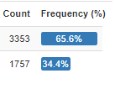
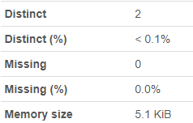
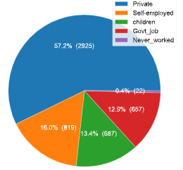
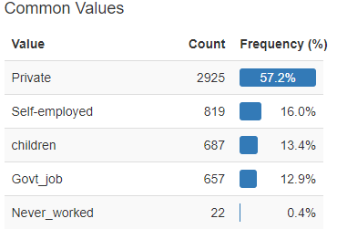
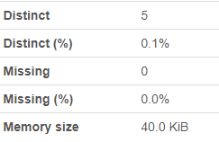
Data Exploration
ever_married
Observations:
Almost 2/3 married
Work_type
Observations:
Private is largest almost 60%

Slide 21
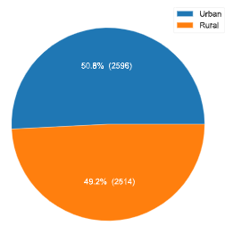
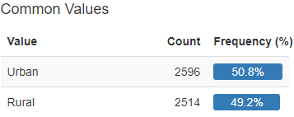
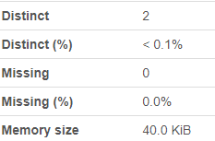
Data Exploration
residence_type
Observations:
Generally balanced with urban slightly more

Slide 22
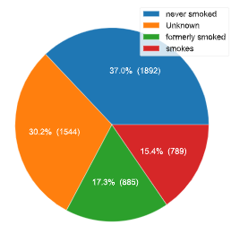
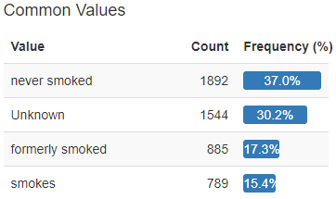
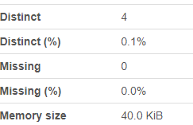
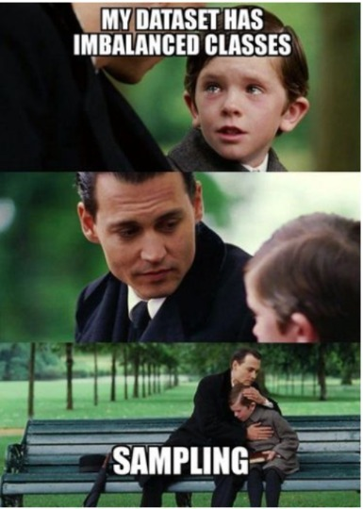
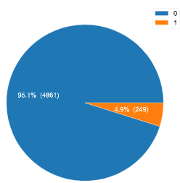
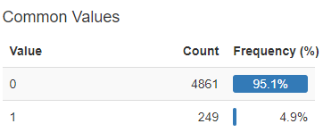
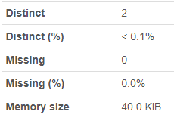
Data Exploration
smoking_status
Observations:
Never smoked is 1/3
Unknown is 1/3
stroke
Observations:
4861 non stroke vs 249 stroke
Ratio 19.5 : 1
High Imbalanced Dataset
Notes:
An imbalanced datasets is one where the labels aren't distributed similarly, that is, you have many more of one label than others. In these situations, the trained classifier often becomes biased towards the majority label class and tends to miss the minority class. This will be an issue in cases where we want to detect that minority class, say in fraud detection, or early detection of cancer cells.

Slide 23
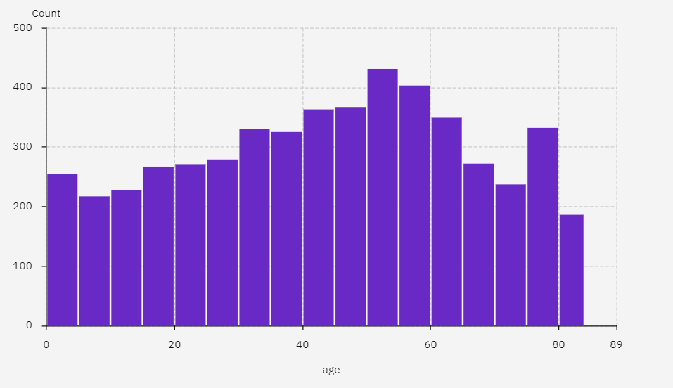
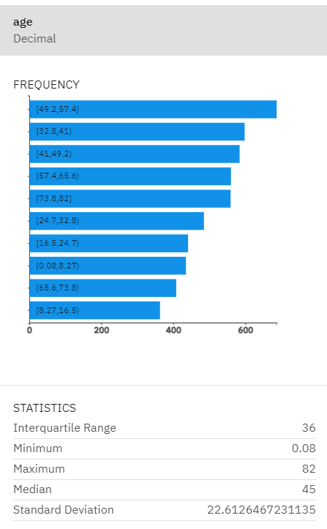
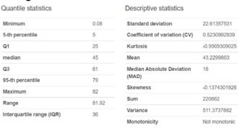
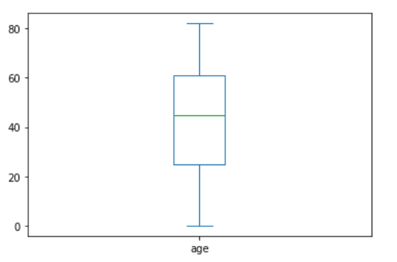
Data Exploration
A distribution of ages from 1 month up to 82 years old.
age
Highlights
- minimum is < I year old
- median age is 45
- Mean age is 43.2
- maximum is 82

Slide 24
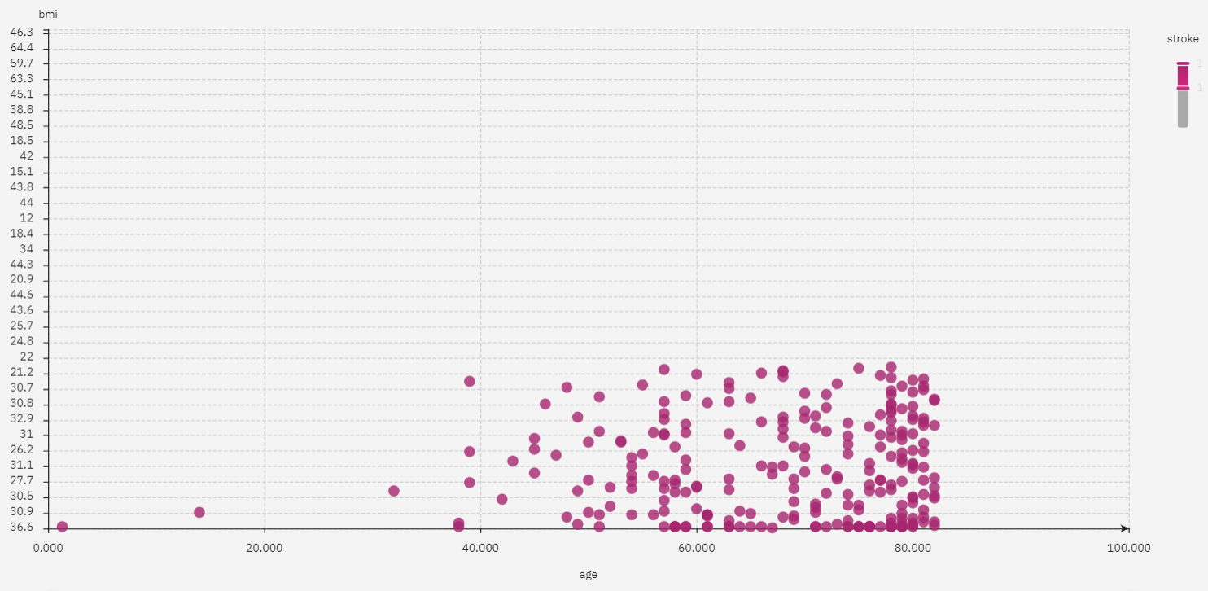
Data Exploration
age
age vs bmi (stroke positive)
There are 249 stroke patients.
2 patients are age 30 and below.
outliers

Slide 25
Data Exploration
age
Actions –
Remove the outliers - patients who are less than or equal to 30 years old from our dataset.
Scope –
Our model is scoped to predict stroke for patients above 30 years old only.

Slide 26
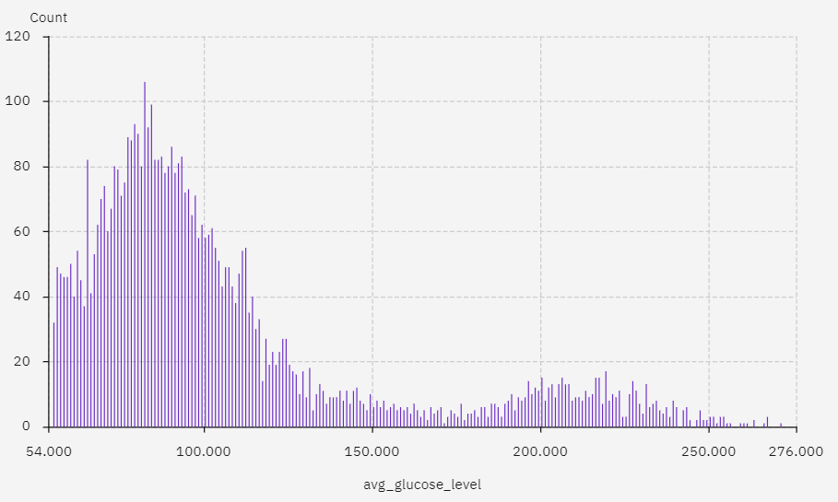
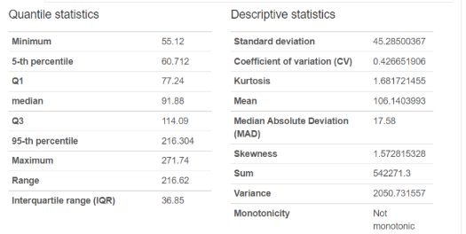

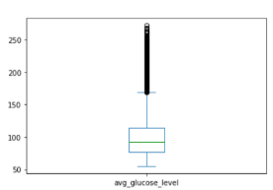
Data Exploration
ave_glucose
Range of ave_glucose is from 55.12 to 271.74.
Median – 91.86
Mean - 106.14
Observations –
Boxplot shown readings above 216 is at 95 percentile is
considered as outlier
216

Slide 27
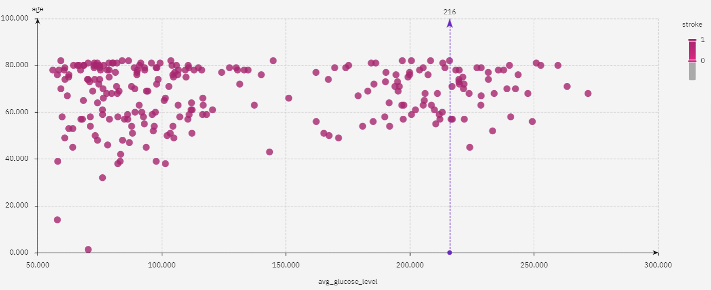
Data Exploration
ave_glucose
Observations –
Further analyze from the scatterplot graph, many strokes incidences (36 counts) were recorded for patients with ave_glucose in the outlier ranges (above 216). These 36 counts account for 14.4% of stroke patient. High glucose reading is an indication of stroke. Team consensus agreed to keep glucose reading unadjusted
Actions –
No action is required.

Slide 28
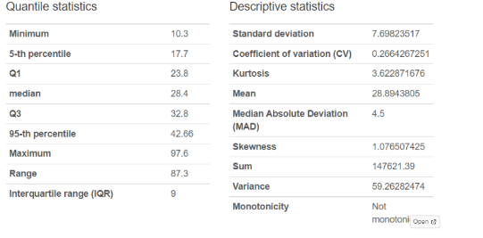
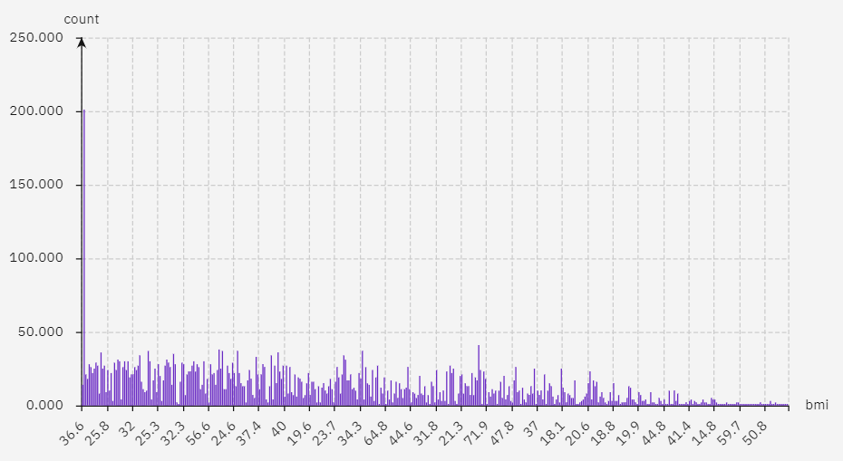
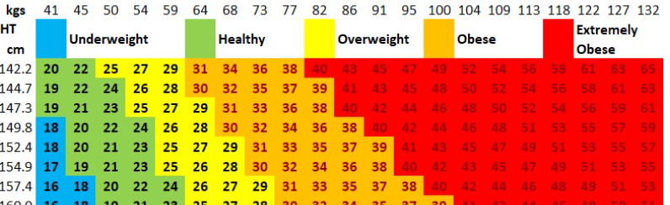
Data Exploration
BMI
Range of BMI is from 10.3 to 97.6
Median – 28.4
Mean - 28.9
There are 201 count label as N/A
From the chart, value
above 60 is for extremely short and obese. We capped
our bmi data at 60

Slide 29
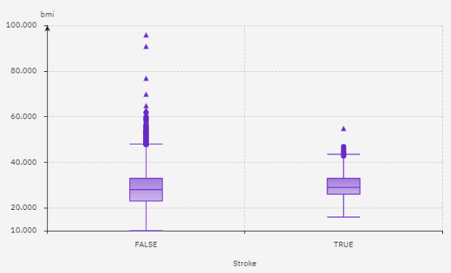
Data Exploration
BMI
Boxplot show the outlier
bmi above 60
Observation – ​
BMI above 60 has 13 counts and they belong to the no stroke class

Slide 30

Data Exploration
BMI
Observations –
All strokes has bmi less than 60
Actions –
Replace missing data with median value
Remove records with BMI above 60

Slide 31
Data Exploration
Data understanding summary
The data contains 5110 observations with 12 attributes.
The feature id served as a unique identifier of a patient. We’ll drop it from the dataset because it is not relevant in predicting the probability of a stroke.
Remove the one record with value ‘Other’ in the gender column.
There are missing data (201 rows) in BMI column; replace them with median
There are three numerical attributes: 'age‘, 'avg_glucose_level‘, 'bmi‘. The rest are categorical attributes.
There are outliers – bmi and age.
We have an imbalanced class problem.

Slide 32



Data Representation and Transformation
Data Transformation
gender (other) to be removed (1 count)
age below 30 to be removed ( 1570 count)
BMI N/A is replaced with median (29.7)
BMI above 60 to be removed ( 4 count)
id feature to be removed
For hypertension, heart_disease and stroke, we replaced "0" with "No" and "1" with "Yes"
Information of Dataset
Feature categories
 | From | To
Rows count | 5110 | 3291
Ratio of no stroke vs stroke | 19.5 : 1 | 14 : 1
* 6.8 % of the dataset (240 rows) is set aside for testing

Slide 33




Selecting data sample for testing
The following factors are deduced from the heat map that affect stroke predictions –
1. age, 2. heart disease, 3. ave_glucose level & 4. hypertension
heart disease and hypertension are categorical data that has higher stroke prediction
We have selected 6.8 % from both Majority (no stroke) and Minority (stroke) data.
Our Training and test dataset is now 3291 rows
Total Count | 3531 |  | Male | 1432
 |  |  | Female | 2099
 |  | 5% of total sampling population |  | Fix 2- heart dis & hypertension- Yes | Fix 1- heart dis - Yes
Stroke | No | 164 |  | 51 | 227
Stroke | Yes | 12 |  | 13
 |  | 177 |  | 64 | 240
 |  |  |  | 1.8% | 6.8%

Slide 34





Data Visualisation
gender
Ratio of Female vs Male is 3:2
age
Range from 31 to 82
Mean is 55
High count at age 31

Slide 35






Data Visualisation
Heart_disease
hypertension

Slide 36






Data Visualisation
ever_married
Majority are married
Work_type
Reduce from 5 to 3 category,
children & never_worked are removed

Slide 37





Data Visualisation
residence_type
Balanced split between Urban and Rural
average_glucose
Distribution is positively skewed

Slide 38



Data Visualisation
BMI
High frequency count for bmi 25 to 30 account for 37% of dataset
Mean is 30.7

Slide 39
Diagnostic Analytics

Slide 40
Attribute Insights
Using Statistical Inference to find correlation between:
a continuous and continuous variable (Pearson)
a categorical and categorical variable (Chi-Square)
a continuous and categorical variable (Boxplot)
20

Slide 41
Attribute Insights
Parametric Correlation Analysis
A method to find correlation between linearly related continuous numerical variables
Tool to use: Pearson correlation
Assumptions:
The data are normally distributed
The data are continuous numerical variables
The variables are linearly related
20

Slide 42


Attribute Insight - Pairplot
•Three continuous numerical variables out of 11 features
- Normally distributed?
•bmi – yes
•avg_glucose_level – +ve skewed
•age – evenly distributed
- Visually observed there is no correlation.

Slide 43

Attribute Insight - Use Seaborn to visualize the Pearson correlation coefficient
•A Pearson correlation coefficient value greater than 0.7 indicates the presence of multi-collinearity
•There are no correlation observed

Slide 44
Attribute Insights
Non Parametric Correlation Analysis
Measure the strength of the direction of the association exists between two variables.
A method to find correlation between categorical, nonlinearly related, non-normally distributed variables
Example of techniques are
Spearman's rank Correlation (ordinal data type)
Chi Square correlation
20

Slide 45


Slide 46

Continuous
Discrete

Slide 47
•Chi-square test of independence
•Coded in Python to create this heatmap
•Display p value
•α = 0.05
Our null hypothesis is that variables are independent.
Objective is to find correlation between variables and we reject the null hypothesis, ie p < 0.05
Summary
heart_disease gender & hypertension
work_type gender & hypertension
smoking_status gender, hypertension
& work_type
stroke hypertension & heart_disease

Slide 48

Attribute Insight
Qns : Does Stroke happen to higher age patient ?
Line of central tendency
Line of central tendency
Stroke does increase in age

Slide 49

Attribute Insight
Qns : Does stroke patient has higher glucose level ?
Line of central tendency
Line of central tendency
Stroke does not show a correlation with avg_glucose_level

Slide 50

Attribute Insight
Qns : Does stroke patient has a higher bmi reading ?
Line of central tendency
Line of central tendency
Stroke does not show a correlation with bmi

Slide 51


Attribute Insights
Qns: Does smoking increases the risk of young and old people having stroke.
Plot show smoking or formerly smoke does not increase in number of people who is having stroke for young and old.

Slide 52


Attribute Insights
Split By Stroke and No Stroke
Stroke risk increases with Age
Generally the presence of stroke increases with age
Females show presence of stroke at younger age (30s) than males (40s)
More females show presence of stroke than males at older age (65 above)
No Male has stroke at age below 40
No Stroke
Stroke
Male – 102
Female - 132
Age 65 & above
Stroke increase with age
Male – 60
Female - 84

Slide 53

Attribute Insights
Overweight and obesity:=> Male BMI vs stroke | Female BMI vs stroke
Males’ BMI between 25 to 35 show more stroke present especially for older age (70 above)
Females’ BMI between 30 to 42 show more stroke present especially for older age (65 above)

Slide 54

Attribute Insights
avg_glucose vs stroke
population show more presence of stroke in older age with average glucose level
population show more presence of stroke in older age and higher bmi

Slide 55






Attribute Insights
Qns: Which work_type influence stroke more?
Self-employed shows highest presence of stroke 8.8% comparing Govt_job and Private
Male gender shows self-employed has the highest presence of stroke 10.2% comparing Govt_job and Private
Males
Female gender shows self-employed has the highest presence of stroke 8.18% comparing Govt_job and Private
Females

Slide 56
Predictive Analytics

Slide 57
Predictive Analytics – Training of the model
3 models trained
(A) Totally Imbalance – Auto AI with dataset 3,000:250
(B) Balance dataset – Auto AI through under sampling with dataset 250:250
(C) Smote – with Auto AI with dataset 3,000:3,000
Settings of the training
(I) Recall optimised
(II) Algoritum used – 2/4
(II) Selected Decision tree classifier, Extra tree classfier, LGBM Classifier, Logistic Regression, Random Forest Classifer & XGB Classifier
(III) Deselected SNAP

Slide 58



Configuration of experiment settings for Totally Imbalanced Dataset
Experiments:
Original datasets
Balanced (under sample)
SMOTE(over sample)
Configurations
Target: Stroke
Prediction: Binary Classification
Positive Class: Yes
Optimized: Recall
Data split: 90% (Train) & 10% (Test)
Features selected: all exclude Stroke
Evaluation
Pipelines
Configure
8 pipelines for each dataset
Auto AI auto generated with various algorithms
Confusion Matrix
Evaluation Matrices
Precision recall curve
Feature Summary

Slide 59


Totally Imbalanced Dataset – Pipeline 7
Totally imbalanced
We fed the data into IBM's Auto AI using Stroke as the prediction column to predict if a patient will be down with Stroke.
Amongst all the 8 pipelines generated after running AutoAI, the Pipeline 7 with a Decision Tree Classifier
Classifier algorithm has the highest rank with a model of 76.9%.

Slide 60





Imbalanced Dataset – Confusion matrix
Pipeline 7- Decision Tree Classifier
What proportion of actual positives was identified correctly?
Pipeline 8 - Decision Tree Classifier
TN | FP
FN | TP

Slide 61


Imbalanced Dataset – Precision recall curve
Pipeline 7 - Decision Tree Classifier
Pipeline 8 - Decision Tree Classifier

Slide 62


Imbalanced Dataset – Model evaluation measure
Pipeline 7 - Decision Tree Classifier
Pipeline 8 - Decision Tree Classifier
Values hidden as accuracy is not a factor for consideration

Slide 63


Imbalanced Dataset – Feature Summary
Pipeline 7 – Decision tree
Pipeline 8 - Decision tree
Both models show the same 3 significant features: Age, heart_disease, square(age)

Slide 64




Balanced Dataset using under sampling
Before | After
3291 | 468
Stroke: *Majority class = No | Minority class = Yes
Challenge:
An imbalanced classification problem is an example of a classification problem where the distribution of examples across the known classes is biased or skewed
Imbalanced classifications pose a challenge for predictive modeling as most of the machine learning algorithms used for classification were designed around the assumption of an equal number of examples for each class. This results in models that have poor predictive performance, specifically for the minority class. This is a problem because typically, the minority class is more important and therefore the problem is more sensitive to classification errors for the minority class than the majority class
Imbalanced
Balanced
13:1
1:1
Notes:
Imbalanced datasets are those where there is a severe skew in the class distribution, such as 1:13 herein the minority class to the majority class.

Slide 65










Training data
Undersampling by Python
AutoAI
Balanced – Undersampling
We fed the data into IBM's Auto AI using STROKE as the prediction column to predict if one is having stroke . Amongst all the 8 pipelines generated after running AutoAI, the Pipeline 2 with Gradient Boosting Classifier algorithm has the highest rank with a model of 80% Precision.
Comparing with other top ranked pipelines based on Recall and F1 score, we decided to explore two models:
For highest Recall is Pipeline 2 - Gradient Boosting Classifier
For 2nd highest F1 is Pipeline 1* - Gradient Boosting Classifier (*since the highest F1 is Pipeline 2)
After looking through the other top ranked pipelines based on Recall and F1 score, we decided to use the model based on the highest Recall followed by F1 and Pipeline 2 is the best model on the balanced datasets using undersampling in majority class

Slide 66


Training data
Undersampling by Python
AutoAI
Undersampling – Confusion matrix
Pipeline 2 - Gradient Boosting Classifier
Recall = 27 / (27+ 8)
Pipeline 1 - Gradient Boosting Classifier
TN | FP
FN | TP

Slide 67


Training data
AutoAI
Undersampling by Python
Undersampling – Precision Recall Curve
Pipeline 2 - Gradient Boosting Classifier
Pipeline 1 - Gradient Boosting Classifier

Slide 68


Training data
AutoAI
Undersampling by Python
Undersampling – Model evaluation measure
Pipeline 2 - Decision Tree Classifier
Pipeline 1 - Gradient Boosting Classifier
Values hidden as accuracy is not a factor for consideration

Slide 69


Training data
AutoAI
Undersampling by Python
Undersampling – Feature Summary
Pipeline 2 - Gradient Boosting Classifier
Pipeline 1 - Gradient Boosting Classifier
Both pipelines show 3 features of high correlation: age, bmi, avg_glucose_level

Slide 70


SMOTE - Synthetic Minority Oversampling Technique
It is an over-sampling technique in which new synthetic observations are created using the existing samples of the minority class.
SMOTE for Imbalanced Dataset (opengenus.org)
(110) SMOTE - Synthetic Minority Oversampling Technique - YouTube

Slide 71



Training data
SMOTE by Python
AutoAI
SMOTE
We fed the data into IBM's Auto AI using STROKE as the prediction column to predict whether a patient would suffer a stroke. Amongst all the 8 pipelines generated after running AutoAI, the Pipeline 1 with a Decision Tree Classifier algorithm has the highest rank with a model of 96.3% Recall.
After looking through the other top ranked pipelines based on Recall and F1 score, we decided to check out two the models:
based on highest Recall, we choose Pipeline 1 - Decision Tree Classifier
based on highest F1 followed by highest Recall, we choose Pipeline 8 - Random Forest Classifier
as we want to err on the safe side for predicting stroke.

Slide 72


Training data
SMOTE by Python
AutoAI
SMOTE – Confusion matrix
Pipeline 1 - Decision Tree Classifier
Recall = 441 / (441+ 17)
Pipeline 8 - Random Forest Classifier
TN | FP
FN | TP

Slide 73


Training data
SMOTE by Python
AutoAI
SMOTE – Precision Recall Curve
Pipeline 1 - Decision Tree Classifier
Pipeline 8 - Random Forest Classifier

Slide 74


Training data
SMOTE by Python
AutoAI
SMOTE – Model evaluation measure
Pipeline 1 - Decision Tree Classifier
Pipeline 8 - Random Forest Classifier
Values hidden as accuracy is not a factor for consideration

Slide 75


Training data
SMOTE by Python
AutoAI
SMOTE – Feature Summary
Pipeline 1 - Decision Tree Classifier
Pipeline 8 - Random Forest Classifier

Slide 76


SMOTE – Testing on unseen data
Pipeline 1 - Decision Tree Classifier
Based on unseen dataset, the result is less than desired. Therefore, more data is required for higher accuracy of model training.
Precision and accuracy are lacking.
Pipeline 8 - Random Forest Classifier

Slide 77
Prescriptive Analytics

Slide 78
Models Comparison based on Holdout Score
 | Recall | F1 | Precision | Log Loss | Rank
Original imbalanced | 100% | 10.35% | 5.4% | 32.669 | 3
Balanced using under sampling | 77.1% | 76.1% | 75.0% | 0.549 | 2
Balanced using SMOTE​ oversampling | 96.1% | 96.6% | 97.1% | 0.167 | 1

Slide 79
SMOTE – Testing on unseen data
Based on unseen test dataset, the result differs with the model's expected score (suspect overfitting).
Therefore, more experiments and data is required for the model training.
Precision and accuracy are lacking.
Pipeline 1 - Decision Tree Classifier
Pipeline 8 - Random Forest Classifier

Slide 80
Summary & Reflection

Slide 81
Constraints and Challenges
Small sample size After cleaning our initial dataset of 5110 patients' records, it is left with about 3284 negative or majority class and 247 positive or minority class.
Dataset is severely imbalanced; it is in the ratio of 13 : 1 a. Best solution – search for more data to bring up the minority class b. Undersampling the majority class c. Oversampling the minority class – SMOTE
Limited features of 11 We will seek advice from the subject matter expert, our medical team, for useful features
IBM runtime usage is limited to 10 CUH and not able to create trial account, we're unable to further explore AutoAI with more experiments.
30

Slide 82
Conclusion
Our best model is not meeting the medical industry standards.
The model shows a high recall of 96.1% and a high precision of 97.1%. However, testing it with an unseen test dataset, the precision is falling short at 6%.

Slide 83
Future Enhancement
More data from the minority class is needed.
More features such as weight, height, body fat %, muscle mass to be collected.
Possible binning the continuous variable, age, BMI (e.g. low, moderate, high), glucose (low, moderate, high).

Slide 84
Our Valuable Experience
Interesting to learn the functionalities of IBM Watson Studio and how it can be used in deploying DS solutions without coding and rapidly
Learning to solve a problem and gain actionable insights that drives business value by going through the 5 stages of a data analytics lifecycle: Planning, Descriptive, Diagnostic, Predictive, Prescriptive
Gained appreciation and experienced the work of a Data Team
AutoAI is a great tool for proof of concept and rapid prototyping; it identifies the significant features and potential algorithms for predicting who might suffer a stroke.
Learned key strategies to solve an imbalanced class problem which are very common especially in the medical field
The display of the Confusion Matrix in AutoAI is spotted and suspected to be incorrect (Suhaimi will confirm with IBM)
Working through the challenges together as a team and leveraging the strength of each member

Slide 85
Special thanks to:
Suhaimi – Our trainer
Fellow team mates who have spent lots of time and effort in this project; great friendship is established

Slide 86






Friendship takes work and we celebrated our friendship
27 Apr 2022 @1045-1330

